Slide 1

Introduction to Psychology
Lifespan Development
Notes:
All text in these slides is taken from https://courses.lumenlearning.com/waymaker-psychology/ where it is published under one or more open licenses.
All images in these slides are attributed in the notes of the slide on which they appear and licensed as indicated.
Cover Image: "Psychology Thoughts." Provided by: Pixabay. Located at: https://pixabay.com/en/head-psychology-thoughts-think-2032751/. Content Type: CC Licensed Content, Shared Previously. License: CC0: No Rights Reserved.

Slide 2
Developmental Psychology
Developmental psychology focuses on how people change.
Cognitive development
Physical development
Psychosocial development
Normative approach

Slide 3
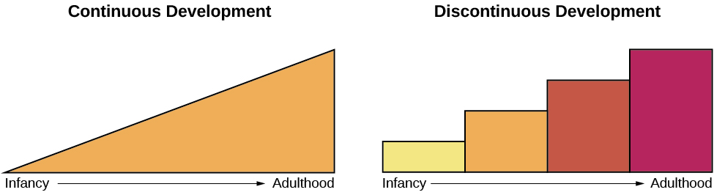
Issues in Developmental Psychology: Continuous or Discontinuous
The concept of continuous development can be visualized as a smooth slope of progression, whereas discontinuous development sees growth in more discrete stages
Notes:
What is Lifespan Development?. Authored by: OpenStax College. Located at: http://cnx.org/contents/Sr8Ev5Og@5.52:-4PGiivG@5/What-Is-Lifespan-Development. License: CC BY: Attribution. License Terms: Download for free at http://cnx.org/content/col11629/latest/.

Slide 4
Issues in Developmental Psychology: One Course of Development or Many?
Is development essentially the same, or universal, for all children or does development follow a different course for each child, depending on the child’s specific genetics and environment?
Do people across the world share more similarities or more differences in their development?
How much do culture and genetics influence a child’s behavior?

Slide 5
Issues in Developmental Psychology: Nature vs. Nurture
Are we who we are because of our genes, or are we who we are because of our environment and culture?
Our unique experiences in our environment influence whether and how particular traits are expressed, and at the same time, our genes influence how we interact with our environment

Slide 6
Freudian Psychosexual Development
Children’s pleasure-seeking urges are focused on a different area of the body, called an erogenous zone, at each of the five stages of development:
Oral
Anal
Phallic
Latency
Genital
Most of Freud’s ideas have not found support in modern research but his ideas about the importance of childhood experiences have had a lasting influence

Slide 7
Erikson’s Psychosocial Development Theory
How we interact with others affects our sense of self, or ego identity
Personality development takes place through the lifespan
At each stage of life there is a conflict that we need to resolve

Slide 8
Psychosocial Stages of Development
Stage | Age (years) | Developmental Task | Description
1 | 0–1 | Trust vs. mistrust | Trust (or mistrust) that basic needs, such as nourishment and affection, will be met
2 | 1–3 | Autonomy vs. shame/doubt | Develop a sense of independence in many tasks
3 | 3–6 | Initiative vs. guilt | Take initiative on some activities—may develop guilt when unsuccessful or boundaries overstepped
4 | 7–11 | Industry vs. inferiority | Develop self-confidence in abilities when competent or sense of inferiority when not
5 | 12–18 | Identity vs. confusion | Experiment with and develop identity and roles
6 | 19–29 | Intimacy vs. isolation | Establish intimacy and relationships with others
7 | 30–64 | Generativity vs. stagnation | Contribute to society and be part of a family
8 | 65– | Integrity vs. despair | Assess and make sense of life and meaning of contributions

Slide 9
Piaget’s Cognitive Development Theory
Cognitive abilities develop through specific stages.
Children develop schemata, mental models, to interpret information
Assimilation is when they take in information that fits with what they already know
Accommodation describes when they change their schemata based on new information

Slide 10
Stages of Cognitive Development
Age (years) | Stage | Description | Developmental issues
0–2 | Sensorimotor | World experienced through senses and actions | Object permanence Stranger anxiety
2–6 | Preoperational | Use words and images to represent things, but lack logical reasoning | Pretend play Egocentrism Language development
7–11 | Concrete operational | Understand concrete events and analogies logically; perform arithmetical operations | Conservation Mathematical transformations
12– | Formal operational | Formal operations Utilize abstract reasoning | Abstract logic Moral reasoning

Slide 11
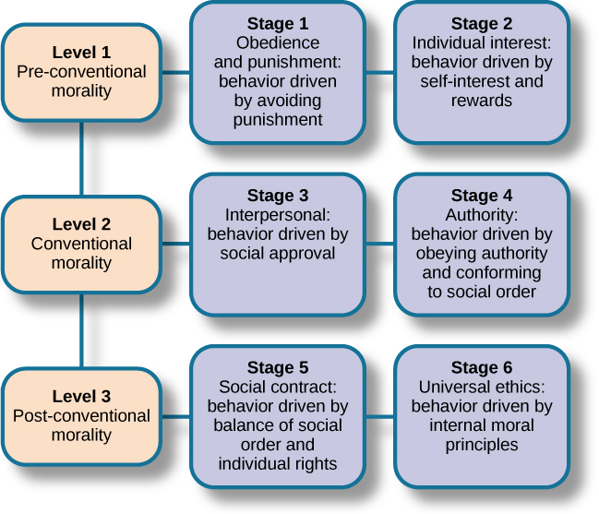
Stages of Moral Reasoning
Notes:
Psychology. Authored by: OpenStax College. Located at: http://cnx.org/contents/4abf04bf-93a0-45c3-9cbc-2cefd46e68cc@4.100:1/Psychology. License: CC BY: Attribution. License Terms: Download for free at http://cnx.org/content/col11629/latest/.

Slide 12
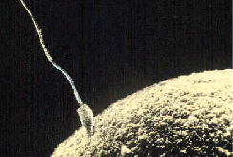
Stages of Prenatal Development
There are three stages of prenatal development:
Germinal
Conception - sperm fertilizes an egg and forms a zygote (right)
Mitosis - process of cell division
Embryonic
Implants itself in the lining of the uterus
Placenta forms
Fetal
Notes:
Stages of Development. Authored by: OpenStax College. Located at: http://cnx.org/contents/Sr8Ev5Og@5.52:b7opmCF3@6/Stages-of-Development#Figure_09_02_Stages. License: CC BY: Attribution. License Terms: Download for free at http://cnx.org/content/col11629/latest/.

Slide 13
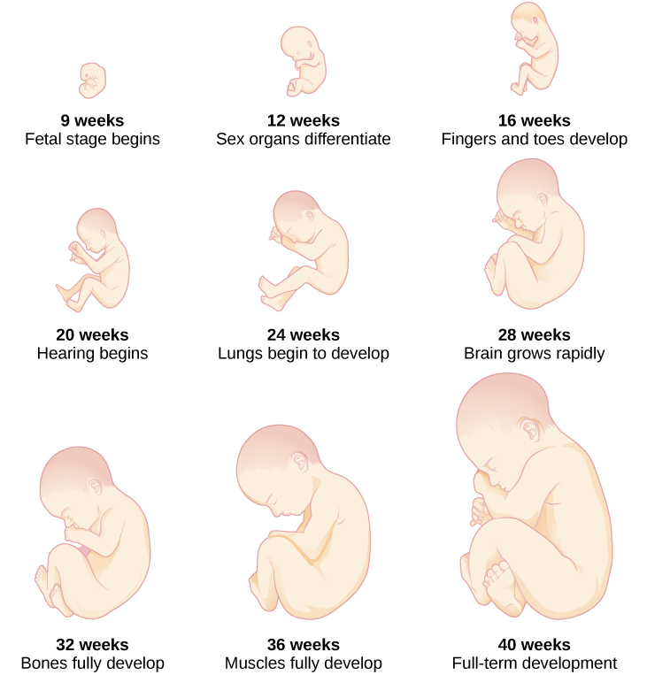
Fetal Development
Notes:
Stages of Development. Authored by: OpenStax College. Located at: http://cnx.org/contents/Sr8Ev5Og@5.52:b7opmCF3@6/Stages-of-Development#Figure_09_02_Stages. License: CC BY: Attribution. License Terms: Download for free at http://cnx.org/content/col11629/latest/.

Slide 14
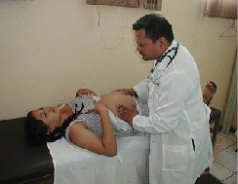
Prenatal Development: Prenatal Care
Medical care during pregnancy that monitors the health of both the mother and the fetus
Reduces the risk of complications to the mother and fetus
Anything the mother is exposed to affects the fetus
Teratogen: biological, chemical, or physical environmental agent that causes damage to the developing embryo or fetus
Critical (sensitive) period: time during fetal growth when specific parts or organs develop
Notes:
(credit: United States Agency for International) in Stages of Development. Authored by: OpenStax College. Located at: http://cnx.org/contents/Sr8Ev5Og@5.52:b7opmCF3@6/Stages-of-Development#Figure_09_02_Stages. License: CC BY: Attribution. License Terms: Download for free at http://cnx.org/content/col11629/latest/.

Slide 15
Infant Development: Newborn Reflexes
All healthy babies are born with newborn reflexes, inborn automatic responses to particular forms of stimulation including:
Rooting reflex: Babies respond to anything that touches the cheek by turning their heads in that direction and sucking
Sucking reflex: Automatic, unlearned, sucking motions
Grasping reflex: Babies automatically grasp anything that touches their palms
Moro reflex: Response to the sensation of falling. Babies spread their arms, pull them back in, and cry

Slide 16
Infant Development: Attachment
Attachment is a long-standing connection or bond with others
It is the main psychosocial developmental milestone of infancy
Secure attachment
Resistant attachment
Avoidant attachment
Disorganized attachment

Slide 17
Childhood Development: Milestones
Age in years | Physical | Personal/ Social | Language | Cognitive
2 | Kicks a ball; walks up and down stairs | Plays alongside other children; copies adults | Points to named object; 2–4 word sentences | Sorts shapes and colors; follows 2-step instructions
3 | Climbs and runs; pedals tricycle | Takes turns; expresses emotions; dresses self | Names familiar things; uses pronouns | Plays make believe; works toys with parts
4 | Catches balls; uses scissors | Prefers social play; knows likes and interests | Knows songs and rhymes by memory | Names colors and numbers; begins writing letters
5 | Hops and swings; uses fork and spoon | Distinguishes real from pretend; likes to please friends | Speaks clearly; uses full sentences | Counts to 10; prints letters and copies basic shapes, Theory of Mind
Notes:
Stages of Development. Authored by: OpenStax College. Located at: http://cnx.org/contents/Sr8Ev5Og@5.52:b7opmCF3@6/Stages-of-Development#Figure_09_02_Stages. License: CC BY: Attribution. License Terms: Download for free at http://cnx.org/contents/4abf04bf-93a0-45c3-9cbc-2cefd46e68cc@5.48

Slide 18

Childhood Development: Cognitive
Children Ages 6-11 understand:
Concepts such as the past, present, and future
Cause-and-effect relationships
Rules
Children have limited attention spans
Notes:
(credit: Edwin Martinez) Stages of Development. Authored by: OpenStax College. Located at: http://cnx.org/contents/Sr8Ev5Og@5.52:b7opmCF3@6/Stages-of-Development#Figure_09_02_Stages. License: CC BY: Attribution. License Terms: Download for free at http://cnx.org/contents/4abf04bf-93a0-45c3-9cbc-2cefd46e68cc@5.48

Slide 19
Childhood Development: Self-Concept and Parenting Styles
The primary psychosocial milestone of childhood is the development of a positive sense of self. Parenting style affects a child’s self-concept. The four parenting styles are:
Authoritarian
Authoritative
Permissive
Uninvolved

Slide 20
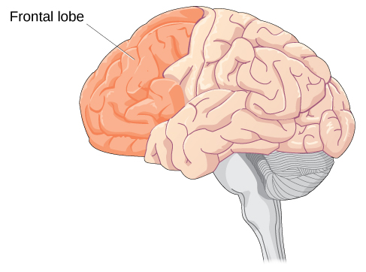
Adolescent Physical Development
Adolescence is the period of development that begins at puberty and ends at emerging adulthood. Adolescents engage in increased risk-taking behaviors and emotional outbursts possibly because the frontal lobes of their brains are still developing
Notes:
Stages of Development. Authored by: OpenStax College. Located at: http://cnx.org/contents/Sr8Ev5Og@5.52:b7opmCF3@6/Stages-of-Development#Figure_09_02_Stages. License: CC BY: Attribution. License Terms: Download for free at http://cnx.org/contents/4abf04bf-93a0-45c3-9cbc-2cefd46e68cc@5.48

Slide 21
Adolescent Cognitive Development
During adolescence, teenagers move beyond concrete thinking and become capable of abstract thought
Ability to consider multiple points of view, imagine hypothetical situations, debate ideas and opinions, and form new ideas
Question authority or challenge established societal norms
Cognitive empathy begins to increase

Slide 22

Adolescent Social Development
As adolescents work to form their identities, they pull away from their parents, and the peer group becomes very important.
Notes:
(credit: Sheila Tostes) in Stages of Development. Authored by: OpenStax College. Located at: http://cnx.org/contents/Sr8Ev5Og@5.52:b7opmCF3@6/Stages-of-Development#Figure_09_02_Stages. License: CC BY: Attribution. License Terms: Download for free at http://cnx.org/contents/4abf04bf-93a0-45c3-9cbc-2cefd46e68cc@5.48

Slide 23

Emergent Adulthood
Newly defined period of lifespan development from 18 years old to the mid-20s; young people are taking longer to complete college, get a job, get married, and start a family
Notes:
(credit: modification of work by Peter Stevens) in Stages of Development. Authored by: OpenStax College. Located at: http://cnx.org/contents/Sr8Ev5Og@5.52:b7opmCF3@6/Stages-of-Development#Figure_09_02_Stages. License: CC BY: Attribution. License Terms: Download for free at http://cnx.org/contents/4abf04bf-93a0-45c3-9cbc-2cefd46e68cc@5.48

Slide 24

Adulthood: Physical Development
Young Adulthood (20s-40s)
Peak muscle strength, reaction time, sensory abilities, and cardiac functioning
Child-bearing years
Middle Adulthood (40s-60s)
Gradual physical decline
Late adulthood (60s +)
Reaction time slows
Senses and muscle strength diminish.
Memory Loss
Notes:
[Photo: jessleecuizon] in Stages of Development. Authored by: OpenStax College. Located at: http://cnx.org/contents/Sr8Ev5Og@5.52:b7opmCF3@6/Stages-of-Development#Figure_09_02_Stages. License: CC BY: Attribution. License Terms: Download for free at http://cnx.org/contents/4abf04bf-93a0-45c3-9cbc-2cefd46e68cc@5.48

Slide 25
Adulthood: Cognitive Development
Fluid intelligence refers to information processing abilities, such as logical reasoning, remembering lists, spatial ability, and reaction time; tends decline over the course of adulthood
Crystallized intelligence encompasses abilities that draw upon experience and knowledge. Older adults often use crystallized intelligence to compensate for declines in fluid intelligence
Adults who engage in mentally and physically stimulating activities experience less cognitive decline

Slide 26

Adulthood: Psychosocial Development
During early and middle adulthood, meaning is found through work and family life
Stable marriages and relationships with adult children improve well-being
Social connectedness and social support are important for positive aging
Notes:
(credit: Gabriel Rocha) in Stages of Development. Authored by: OpenStax College. Located at: http://cnx.org/contents/Sr8Ev5Og@5.52:b7opmCF3@6/Stages-of-Development#Figure_09_02_Stages. License: CC BY: Attribution. License Terms: Download for free at http://cnx.org/contents/4abf04bf-93a0-45c3-9cbc-2cefd46e68cc@5.48

Slide 27
Death and the Five Stages of Grief
In some cultures, death is accepted as a natural part of life. Hospice is a service that provides a death with dignity; pain management in a humane and comfortable environment; usually outside of a hospital setting.
Elizabeth Kübler-Ross proposed five stages of grief:
Denial
Anger
Bargaining
Depression
Acceptance

Slide 28
Practice Question
What is an example of a discontinuous theory of development?
Notes:
Discontinuous theories of development have discrete stages such as Piaget’s stages of cognitive development.

Slide 29
Quick Review
Discuss the three major issues in development: continuity and discontinuity, one common course of development or many unique courses of development, and nature versus nurture.
What are Freud’s theory of psychosexual development, Erikson’s theory of psychosocial development, Piaget’s stages of cognitive development, and Kohlberg’s theory of moral development?
What are the stages of prenatal development? Why is prenatal care important? What are the infant reflexes?

Slide 30
Quick Review Continued
What physical and cognitive development occurs from infancy through childhood?
What emotional development occurs from infancy through childhood, including attachment and the development of a self-concept?
What physical, cognitive, and emotional development occurs during adolescence and adulthood?
What are Kübler-Ross’s five stages of grief?

